Slide 1
Orleans Virtual Meetup 4
Reuben Bond

Slide 2
Reuben Bond
From Melbourne, Australia
Worked on Azure Active Directory @ Microsoft in Redmond, WA
Fun solving distributed systems problems for the team
First encountered Orleans, but no experience with it
Moved back to Melbourne & started a company with friends from Microsoft & University.

Slide 3
Brief
FreeBay: Solving problems with Orleans
Orleans Web Console
Authorization & Authentication in Orleans
Event Sourcing

Slide 4

FreeBay
Mobile app
Users can give away unwanted household items by taking a picture
Users can see nearby items, claim them, then organise pickup
Like a minimalist Craigslist/Gumtree, but only for free things
Built on Orleans, running in Azure
Everything is real-time. Reactive Extensions everywhere
If you’re looking at a listing and it gets updated, your screen changes to match

Slide 5
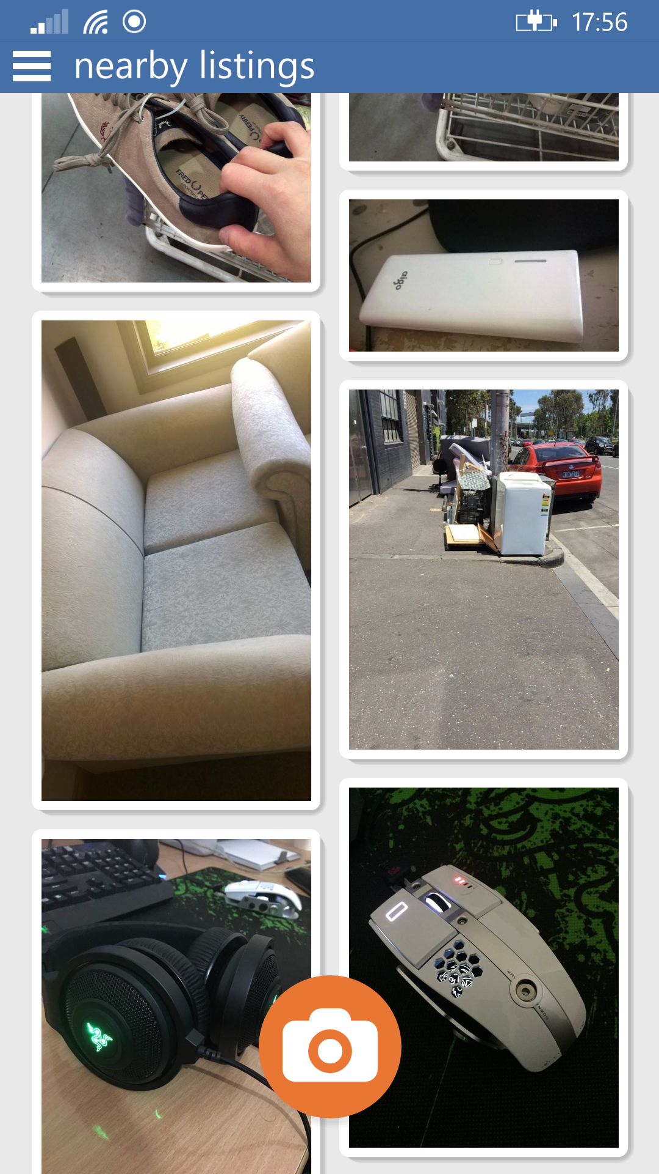
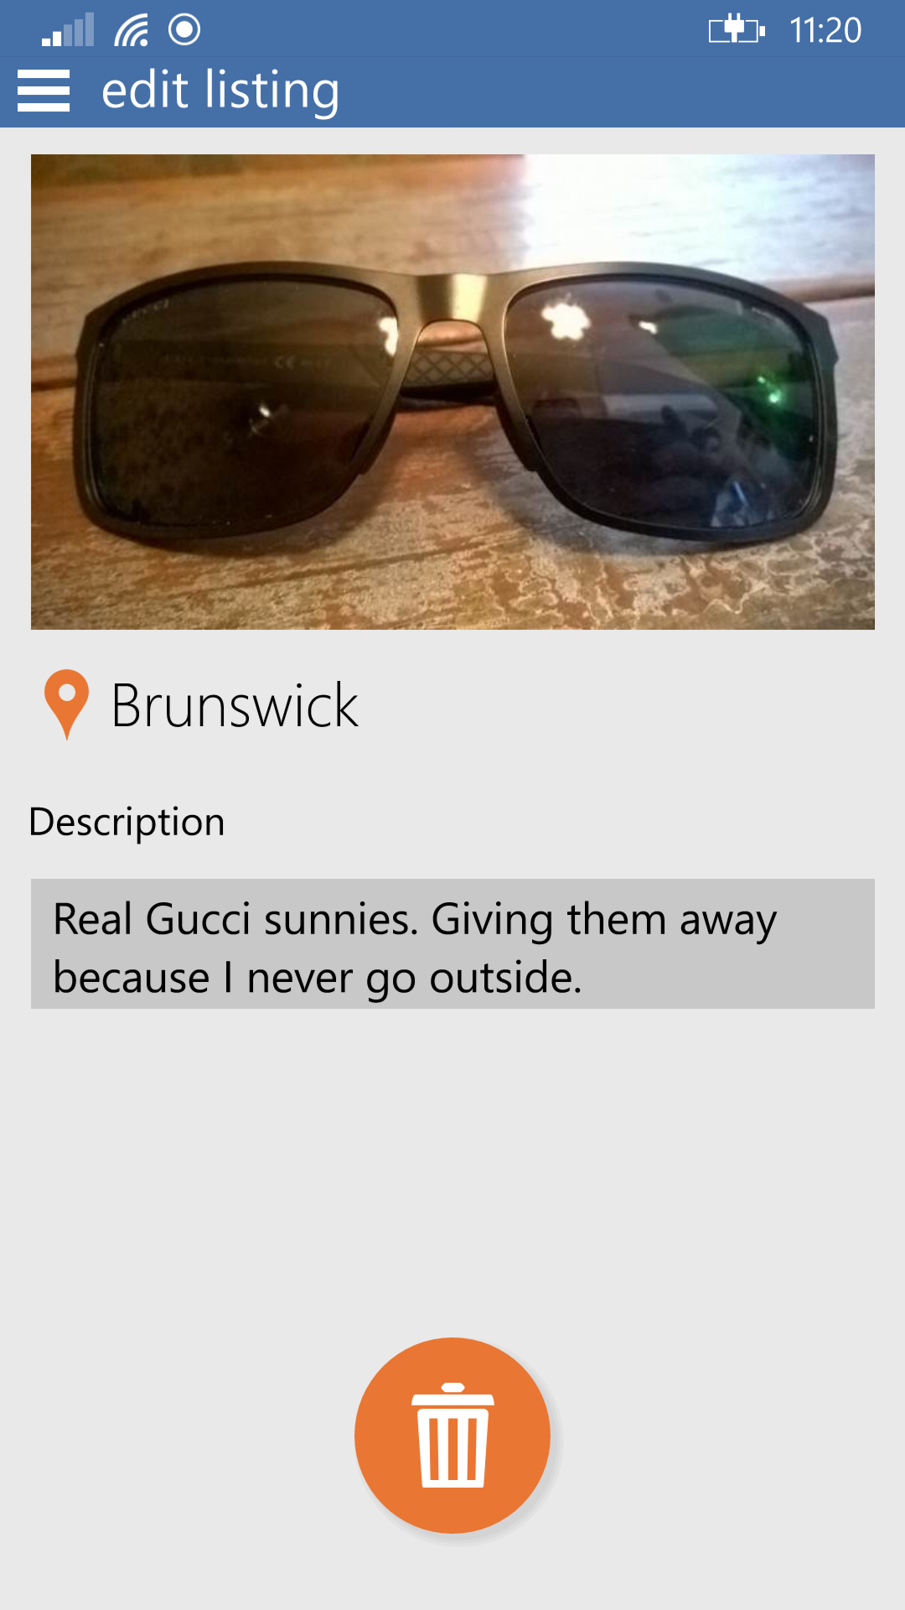
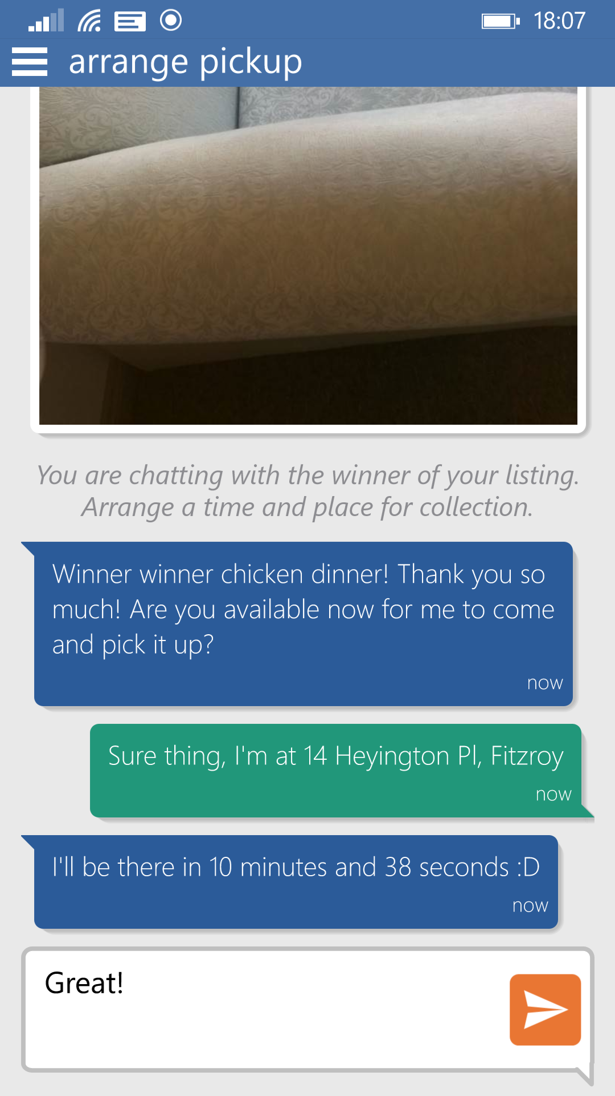

Slide 6
Modelling

Slide 7
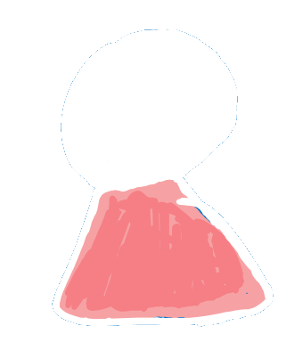
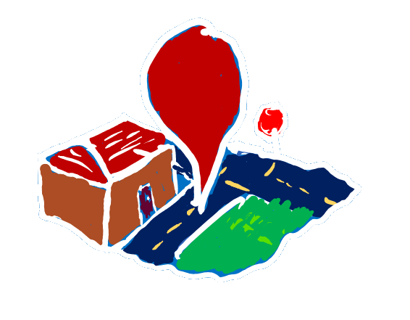
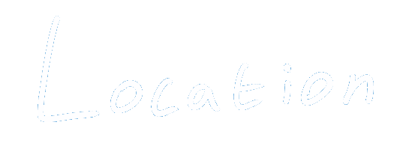
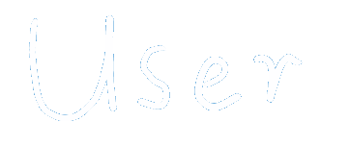
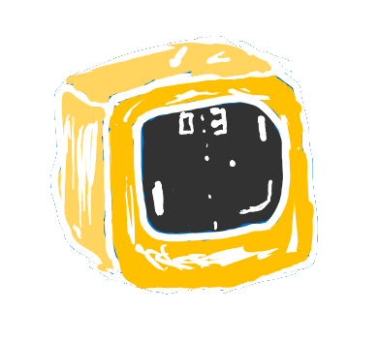
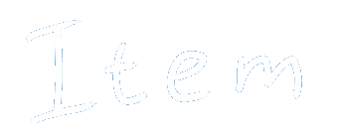
Acts on the human’s behalf
The point of the whole system
Pub/Sub Hub – for discoverability
Location
Items
Notifications
Auth
Images
Location
Owner
Tags
Lat/Long
Suburb Name
Items
Observers
Plus a few others: ChatRoom, Email, SMS, BanHammer, Admin, GeoLocation…
Notes:
(Reuben)
Conceptually, we have users, items, and locations.
Each of them have various properties.
In Orleans, each of these is represented by a Grain.
A user takes pictures to create items which exist at a given location.
Users observe locations to see newly listed items near them so that they can claim them and organise pickup.
Now there are other kinds of grains in our system which aren’t shown here.
For example, when a user claims an item, the users and the claimed item join a ChatRoomGrain where the users arrange their rendezvous.
How about the location, though? Effectively, each LocationGrain holds a reference to all of the nearby items which aren’t yet claimed or expired.
If we had just one location grain, users in Australia would be seeing items in China and everyone would be hammering this one big bottle neck for every request.
Instead, we need to divide the problem up so we can tackle it.
This is where Orleans really starts to shine.

Slide 8
How do users find items?

Slide 9
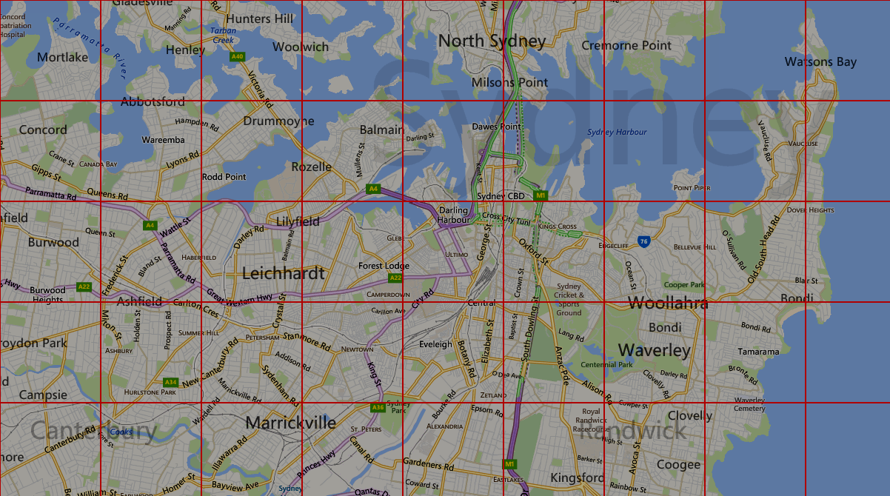
Divide & Conquer
Users are only interested in nearby items.
If they’re in Sydney, don’t send them to Vladivostok for a busted up TV!
Orleans does not provide you with indexes
Sticking point for new users
Solution:
Divide the world up into 2Km*2Km grid
Users subscribe to all grids within a certain radius
Items are published

Slide 10
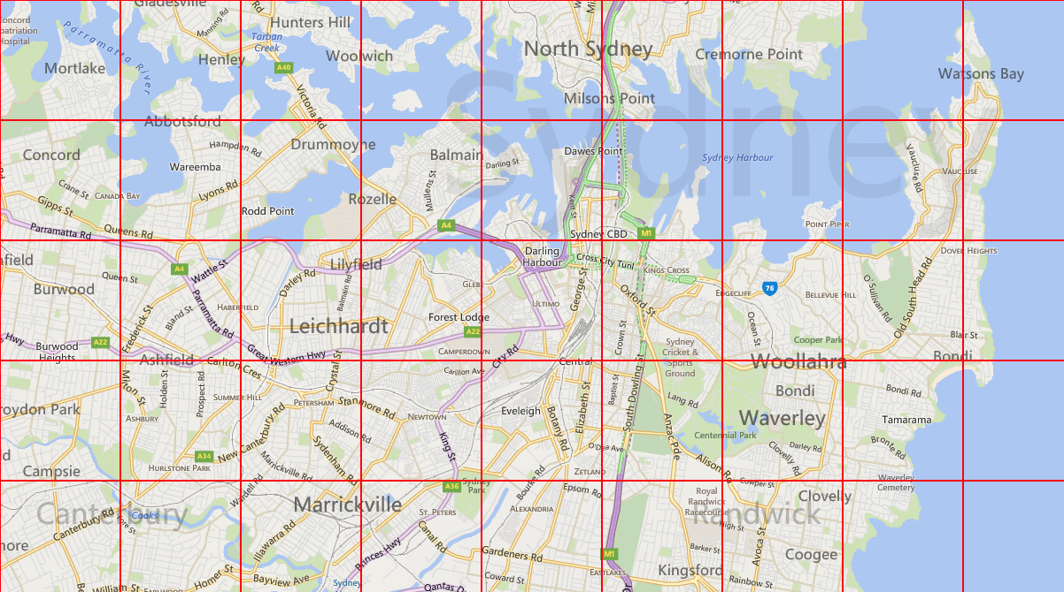

Slide 11
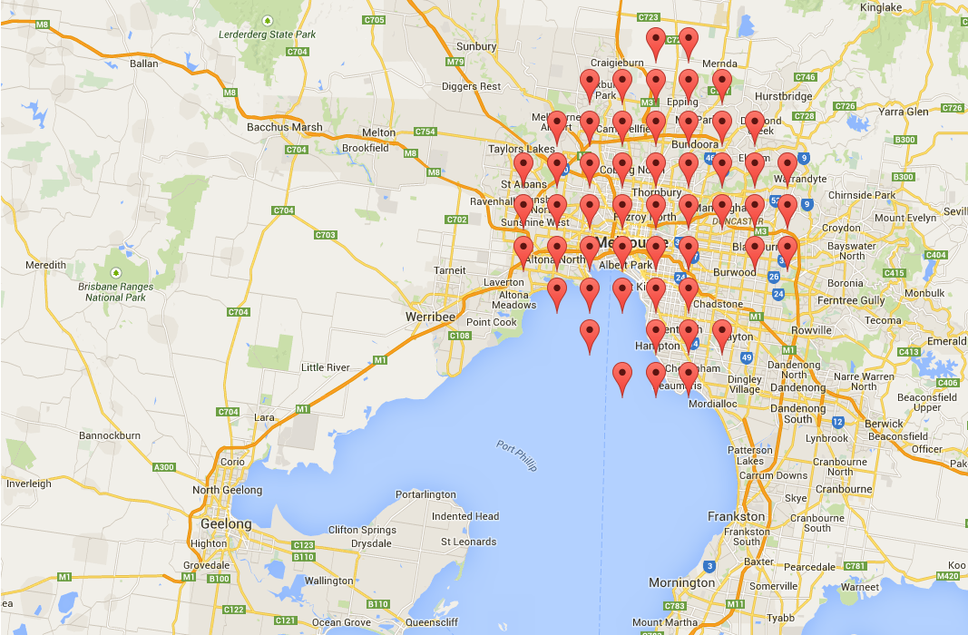
Ignore the ‘holes’ – I was debugging them at the time ☺

Slide 12
Administration on a budget

Slide 13
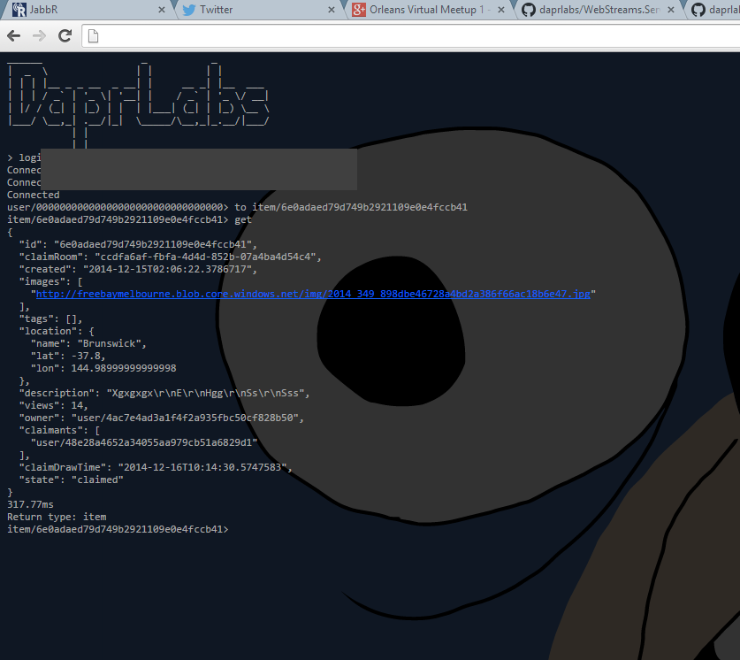

Slide 14
How does the console work?
Reflect onto actor assemblies, generate an ActorDescription for each actor
Use those to generate & compile an EventDispatcher using Roslyn
EventDispatcher is basically a giant switch of switches – switching on actor type and then method name.
Tiny ASP.NET Web API service pipes requests from JS console to EventDispatcher
Simple!

Slide 15
Authentication & Authorization
Each user has a corresponding UserGrain
Apps authenticate with UserGrain, which stores hashed user password
IUserGrain reference passed in every call from Web-tier to every actor.
Actors use this for authorization:
Is this user our owner? – Check user’s id against state.
Is this user banned? – await user.IsBanned()
Is this user an admin? – await user.IsAdmin()
(something like that…)

Slide 16
Authentibles

Slide 17
Authentication & Authorization v2.0
Our new system is more complex: OAuth, Roles, Claims…
Passing IUserGrain around causes many round-trips as grains ask questions like “are you an admin?”, etc.
Instead, use Orleans’ RequestContext dictionary
Grab claims from ClaimsPrincipal, stuff them into RequestContext
Grains still handle their own AuthZ, but now they have all the info needed

Slide 18
Event Sourcing
We need auditing. We want better debugging.
Event Sourcing (basically a write-ahead journal, like most filesystems) gives us that.
All writes emits an event, which can be viewed in a portal & replayed in case of failure.
Hate boilerplate!

Slide 19
Event Sourcing v1
Capture current request
Persist when user calls await this.WriteJournal();
About as terse as possible.
But: too magic, bloody frightening, hard to test!
https://github.com/daprlabs/Orleans.Journal – outdated!

Slide 20
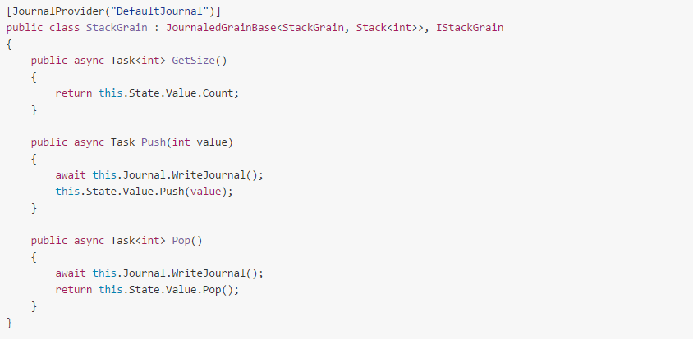
Event Sourcing v1

Slide 21
Event Sourcing v2
Use CodeGen from Console to create EventProducer which implements actor interface
When calling an EventProducer method, an event is emitted to the journal
So we can record exactly which method was called.
Good testability!
Fairly terse!
Not scary!

Slide 22
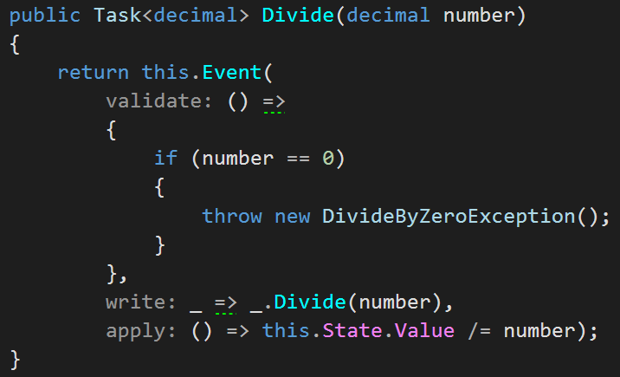
Event Sourcing v2

Slide 23
Event Sourcing v2
Emitting an event
Replaying an event
Actor
EventProducer
IJournal
Effectively the inverse of each other
IJournal
EventInvoker
Actor

Slide 24
Quick demo to show I’m not just making stuff up.

Slide 25
Thanks ☺ Questions?
The code: https://github.com/ReubenBond/OrleansEventJournal

